Slide 1
FUNDAMENTALS OF THERMAL ANALYSIS AND DIFFERENTIAL SCANNING Calorimetry Application in Materials Science Investigations
Analiza cieplna i kalorymetria różnicowa w badaniach materiałów
Tomasz Czeppe
Lecture 4 (5).
Thermal analysis- basic classifications, differential thermal analysis and thremogravimetric thermal analysis

Slide 2
Outline of the methods of the thermal analysis -1
METHOD | ABR. | RANGE (ºC) | MEASURED PROPERTY | APPLICATION
Differential Thermal Analysis | DTA | 100 –- 2000 | temperature difference | tempertures of phase transformation or chemical reaction
Differential Scanning Calorimetry high-temperature (calibrated DTA) | DSC (DTA) | 100 –- 1700 | heat flux | tempertures of phase transformation or chemical reaction, transformation enthalpy, heat capacity
Differential Scanning Calorimetry | DSC | -170 –- 600; 710; 1000; | heat flux | heat capacity, temperatures end enthalpy of phase transformation, chemical reactions
Differential Scanning Calorimetry | DSC | -170 –- 600; 710 | power compensation | heat capacity, temperatures end enthalpy of phase transformation, chemical reactions
Pressure Differential Scanning Calorimetry | PDSC | -170 –- 600; 710 | heat flux under increased hydrostatic pressure | heat capacity, temperatures end enthalpy of phase transformation, chemical reactions under pressure
Modulated Differential Scanning Calorimetry | TM-DSC MDSC | -170 –- 600; 710 | heat flux under modulated amplitudę and frequency of heat tranfer | reversibiity of the phase transformations, reversible heat capacity, temperatures end enthalpy of phase transformation, chemical reactions,

Slide 3
Outline of the methods of the thermal analysis -2
METHOD | ABR. | RANGE (ºC) | MEASURED PROPERTY | APPLICATION
Ultra – high rate DSC (Mettler Toledo) | Flash DSC-1 | 30 -500; -95 -420; rates: cooling 6 -240.10³,heating 30- 2,4.10⁶ K/min | power compensation Peltier cell | phase transformations, temperatures and enthalpies in extremely high rats of temperature changes
Isothermal titration calorimetry | Nano-ITC | 2 –- 80 K | power compensation Peltier cell | biopolymers, enzymes and others.; thermodynamics of molecules, molecular bonding interactions
Nano- Differential Scanning Calorimetry Micro- DSC | Nano-DSC MC DSC | -10 –- 130 or 160; -40 – 150; | power compensation Peltier cell heat capacity | protein, makromolecules in solutions, pharmaceutics, thermal stability, bonds, pressure influence;
Thermogravimetry | TGA | TP –- 1500 ; 1600 | mass change | processes with mass change, oxidation , decomposition synthesis;
Thermogravimetry + DTA | SDT | 100 –- 1600; 1700 | Mass change, temperature difference, heat flux calibrated | processes with mass change and heat effects, oxidation , decomposition synthesis;

Slide 4
Outline of the methods of the thermal analysis -3
METHOD | ABR. | RANGE (ºC) | MEASURED PROPERTY | APPLICATION
Sorption analysis (+ Raman spectroscopy) Thermogravimetric sorption analysis | VTI - SA GVS | 5 - 150 5 –- 85 | changes of mass in a result of sorption of water vapor or other organic liquids; | aadsorption, desorption of water, isotherms of adsorption, processes and phase composition of pharmaceutics, amount of the crystalline phase, kinetics of draying
Dilatometry | DL | 25 – 2000 0,1 – 50 K/min | thermal expansion, changes of density with temperaturę; | phase transformations, sintering, oxidation, ceramics, super-hard materials, high temperature alloys and ceramics;
Thermomechanical analysis Dynamo-thermomechanical analysis | TMA DTMA | -150 - 1550 0,01 - 50 K/min 0,001 – 3 N 0,01-1 Hz | thermal expansion or contraction under loads of different character, softening, thermal volume change; | thermal expansion coefficients, deformability in temperature, phase transformations, dumping capacity, brittleness, softening temperatures
Dynamo- mechanical analysis | DMA | -170 - 600 0,01 -100 Hz 16 N | elastic reaction under high frequency loads of different character; | elastic modulus, coefficient of vibrations dumping, stiffness coefficient, phase transformations, deformability, composition;

Slide 5
Outline of the methods of the thermal analysis -4
METHOD | ABR. | RANGE (ºC) | MEASURED PROPERTY | APPLICATION
Solution calorimetry |  |  | enthalpy of mixing
Drop calorimetry |  |  | Enthalpy of mixing
Heat conductivity | DTC | thickness to 32 mm /0,1mm | Stationary heat conductivity λ = (Q/A)/(ΔT/L) | heat conductivity coefficient λ at room temperature for the solid and liquid samples and thin coatings;
Heat diffusivity (laser or xenon lamp) | DLF LFA | -150 – 2800 thickness from 6 mm | pulse heat diffusion α = λ/ρC_{p} | coefficients α, λ and C_{p} in function of temperature for solid and liquid phases and coatings;

Slide 6
Classical differential thermal analysis and high temperature DSC – types and construction
„improved DTA”
„high temperature DSC”
„DTA with
no temperature gradient”
„classical DTA”
„temperature gradient DTA”
Tp
Ts
T₀
Tp
Ts
T₀
ΔQ
dT = Tp-Ts ~ dQ
signal dQ/dT ~ Tp-Ts
signal dT = Tp-Ts

Slide 7
Classical differential thermal analysis and high temperature DSC – operation
The DTA in classical construction do not offer any way of the heat transfer except gas convection and radiation in high temperatures. The signal supplies the differential d(Tp-Ts)/dt while T=T₀ + (dT/dt)dt = Θ = programmed current temperature. The unit for the signal is [ΔTºC.s/mg].
DTA Supplies similar results like precise differential temperature (DT) measurements but in relations to the standard preferably of the similar mass. This compensation in heat capacity supports the shape of the base line.
The lack of the controlled heat flux density (look our previous lecture about heat conductivity) causes thermal gradients in the sample, so the important requirement is very small mass of both sample and standard.
The next problem generated by the system is a sensitivity for the relative position of the sample and standard versus respectful thermal elements, and a geometry of the active elements of the system, hard to preserved in the sequence of measurements.

Slide 8
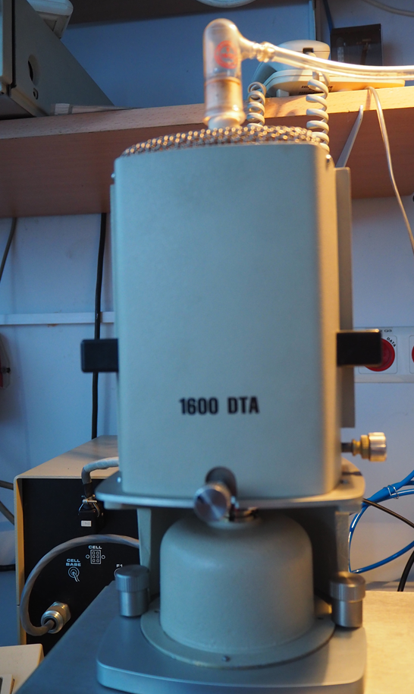
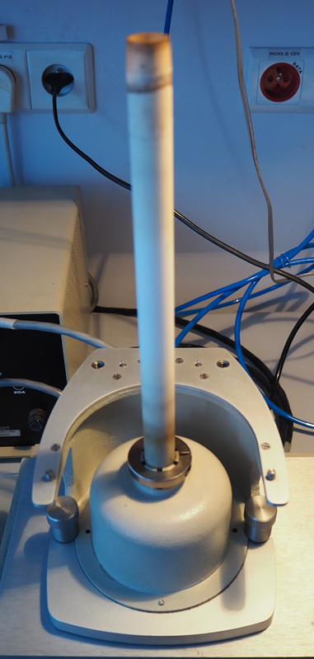
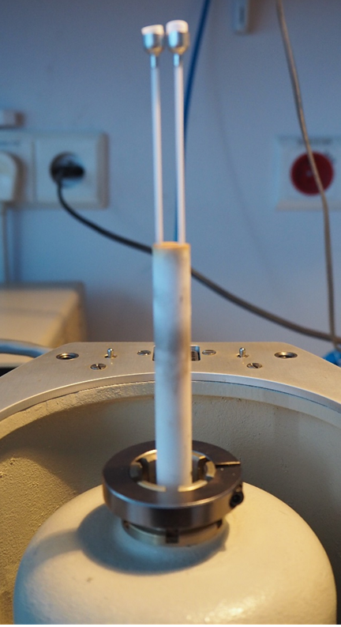
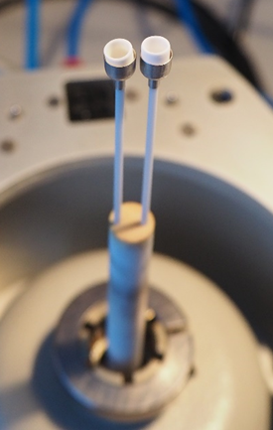
Classical differential thermal analysis construction
Liners and cups
Screws regulating
furnace linearity
„classical DTA”
„temperature gradient DTA”
Gas temperature equilibration
A small masses are important to avoid temperature gradients.

Slide 9
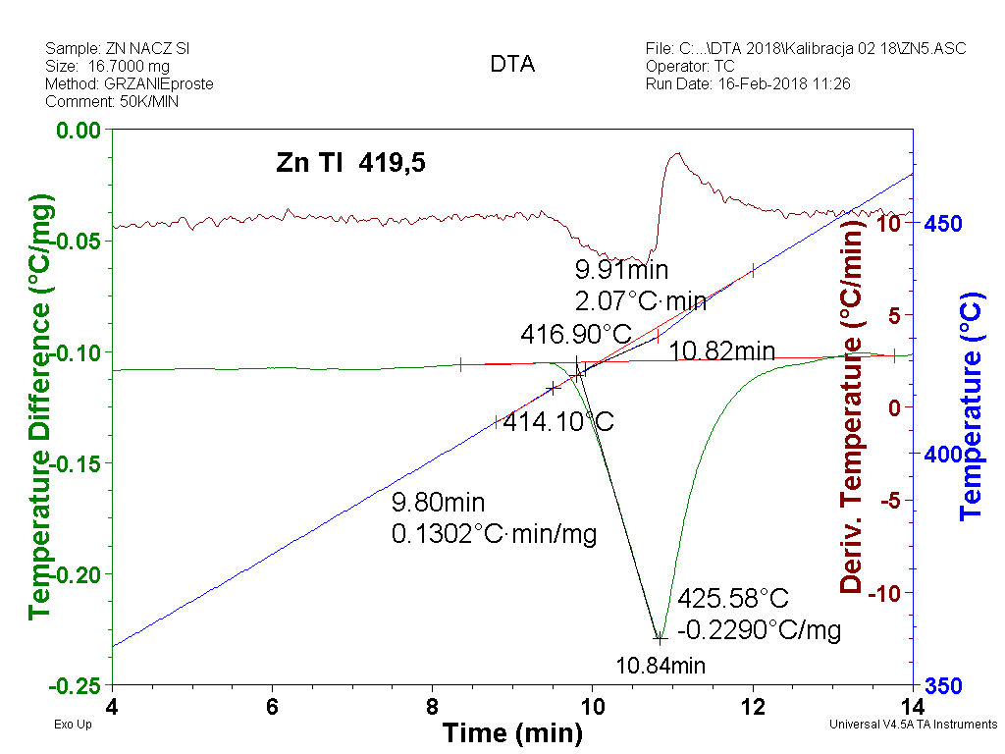
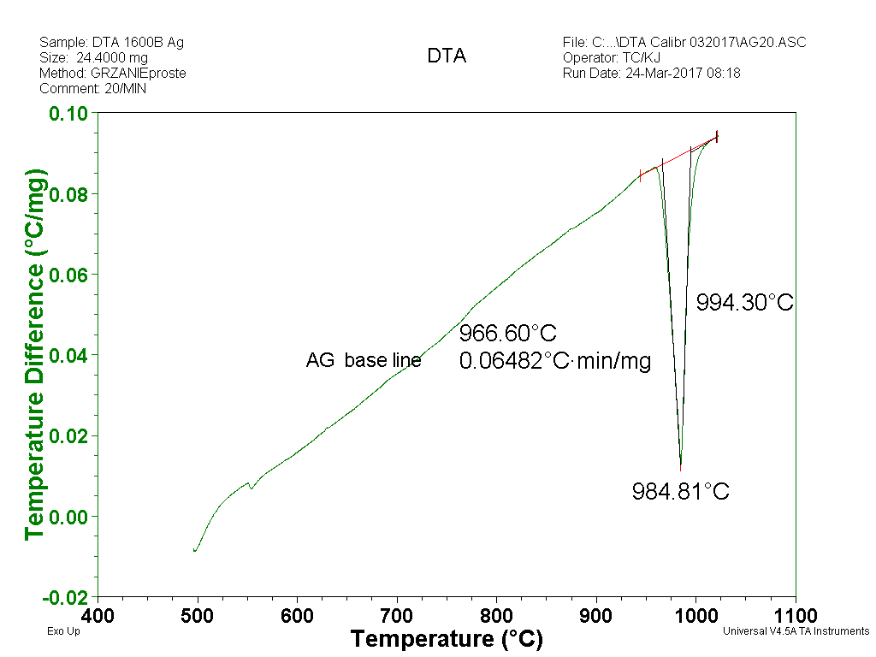
Classical differential thermal analysis signals /base line
It should be remembered that the signal measurements are in two axis; time and temperature. The results in the time function are not useful in many cases so they are presented in function of temperature. The unit for the signal is [ΔTºC.s/mg].
The DTA supplies signals T=f(t) and DT=f(t) similar to differential temperature (DT) measurements but in relations to the standard (look the left figure, a blue and brown lines). This compensation in heat capacity supports the shape of the base line, which in a best case may be like in the right figure. Non monotonous base line may cause serious problems.

Slide 10
Classical differential thermal analysis advantages and disadvantages
The very high precision of the temperature measurement is decreased by the external factors like temperature lost by convection and radiation at high temperatures, lack of symmetry between thermoelements and the furnace and the not perfect thermal contact between samples and thermoelements.
The advantage of the system of DTA is simplicity, direct measurement of the primary factor that is temperature, what gives commonly a sharp jumps on the resulting signals (*).
The other important advantage is less of the expensive elements in construction which may be destroyed at high temperatures e.g. by evaporation (Pt).
This type of DTA remains good equipment for solving problems in the thermal analysis in the case if we want to determine the critical temperatures or temperature range of the processes but not the amount of the heat flux or heat capacity of the material .

Slide 11
Classical differential thermal analysis and high temperature DSC – types and construction
DTA as all the TA methods bases on the temperature scale. This makes the standardisation of temperature crucial for the true results. For this type of method the calibration is most simple, concerns only temperature.
It should be remembered that very important role play also external elements and conditions used in experiments, like type of caps and covers, type of gas for purification, the flux of the gas and possibly other factors.
Typical cups for the DTA of this type are somehow different in the form from the others: some of them is shown in next slides.
The classical DTA or modification of high temperature DSC to it may be advised for very high temperature experiments, that is above 1000 ºC.

Slide 12
Classical differential thermal analysis and high temperature DSC – types and construction
The calibration procedure includes measurement of the series of temperatures of melting for the standard very pure elements, which may be supplied by the TA equipment producers. The data introduced to the equipment modify slightly the length of the scale and shown temperatures. This must be done for the requested heating rate and in relations to the expected temperature range of interest. How many points may chosen depends on the instrument and experimental requirements. The corrections should work like this:
The heating rates: due to massive furnace required for high temperatures the heating rates should not be very high, 1 – 50 deg/min. Commonly 5, 10 and 20 deg/min is applied. Also cooling is rather slow or very slow.
Ts
ΔT1
ΔT exp.
T_{E}
ΔT2

Slide 13
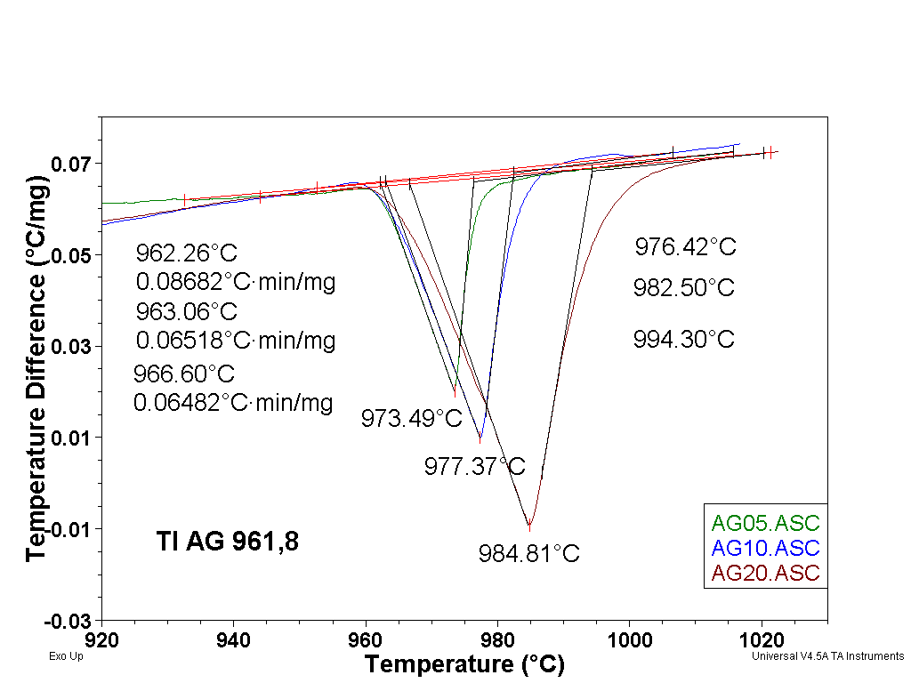
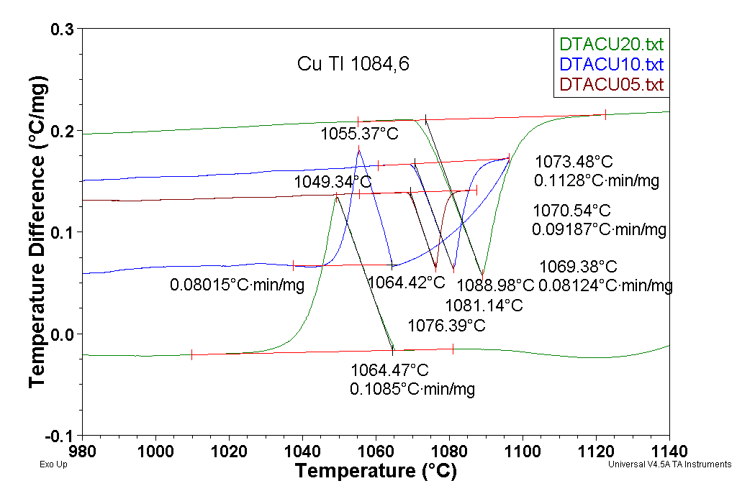
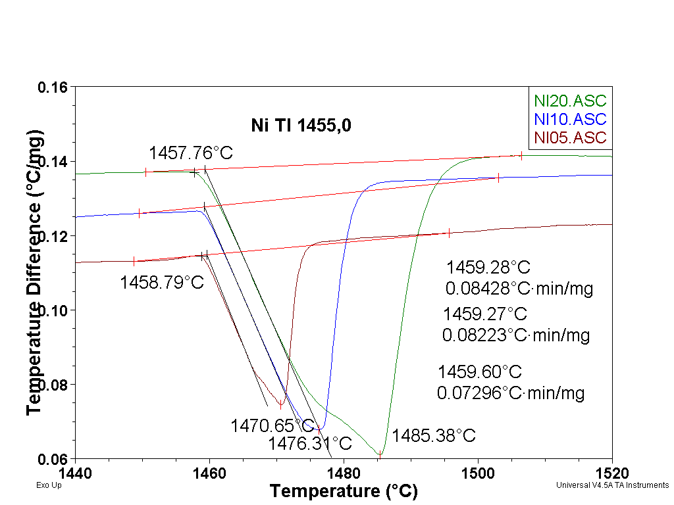
Classical differential thermal analysis – the shape of the signals and calibration procedure
The signals supplied by the system of DTA are generally sharp. (*).
The calibration uses melting temperatures of pure elements, e.g. Zn, Ag, Au and Ni. The sharp temperature of crystallization are not used because of overcooling (see Cu example). Cu is not advised because of the influence of oxides.
The determination of the melting temperature is influenced by the heating rate.
Also the thermal lag is very sensitive for the heating rate and sample mass.

Slide 14
Classical differential thermal analysis– types of the crucibles
Crucibles reveal great influence on the quality of the results, especially in the sensitive DSc measurements. They influence sensitivity and time constants.
The following point are important choosing a crucible:
Protection of the measuring system against contamination-
No direct contact with the sample;
No increase of the time constant;
High heat conductivity-preferable flat bottom, decrease temperature gradients;
Inert material;
No transitions in material –hard to achieve!
Free access of atmosphere in crucible but no P increase;
DSC, TGA- time for waiting in the robotic system may be dangerous- lids, hermetically sealed crucibles, a proper shape;
Crucible material
Crucible volume
sample
crucible
Temperature range
Sample robot
atmosphere
TGA, DSC, SDT

Slide 15
Classical differential thermal analysis– types of the crucibles
Typical choose of the crucible material:
TGA, HTDSC- aluminum oxide or plated with Pt;
Pt large and tall (dangerous!);
Small or large e.g. 150-900ml;
Cu pans with lids – deoxidation activity-stabilize the sample;
High or medium pressure crucibles- commonly steel with lids with o-ring rubber, Cu plated Au;
Steel crucibles plated with Pt or Au;
Typical cups for the DTA different in the form from the others: they let to contact thermoelement with the sample very near through the thin wall. Caps may be used from quartz, Pt (up to 900ºC) and ceramics e.g. Al₂O₃. For the DTA they are commonly not covered, as not controlled heat transfer has no important influence on the temperature.

Slide 16
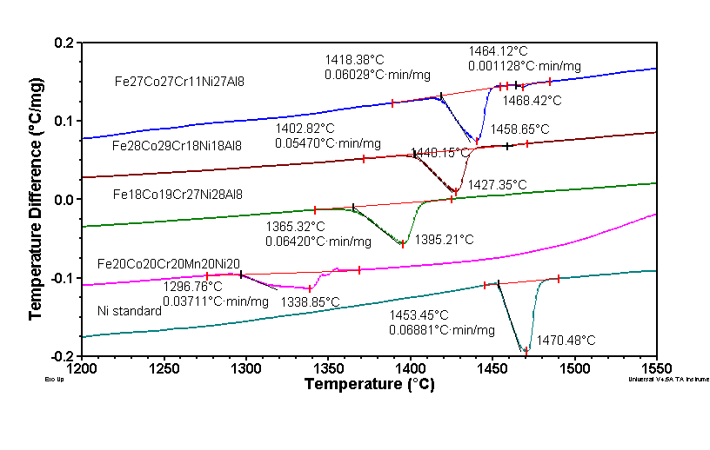
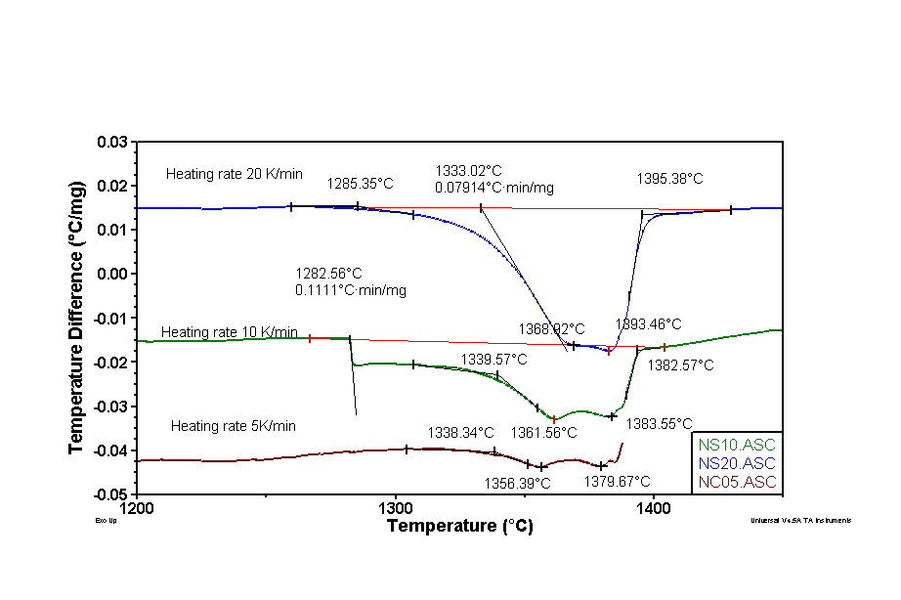
Classical differential thermal analysis– some examples of application
The process of the sample preparation in thermal analysis does not change in any sens chemical or physical state of the investigated matter;

Slide 17
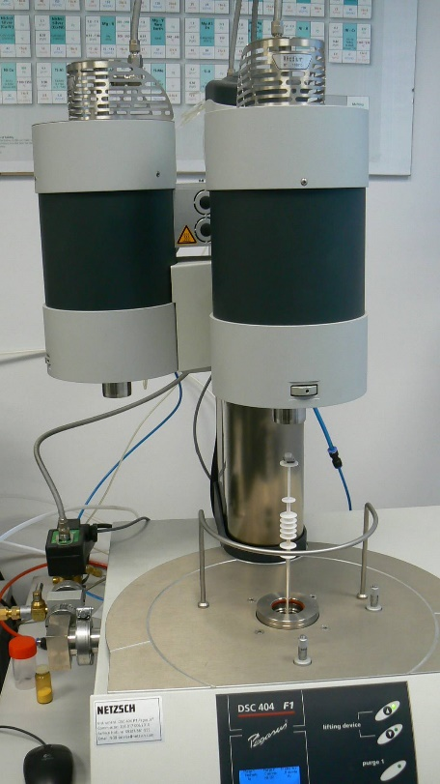
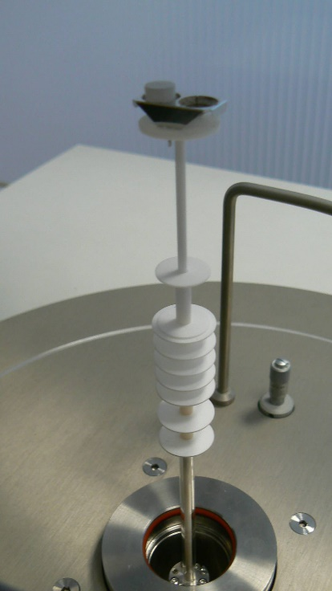
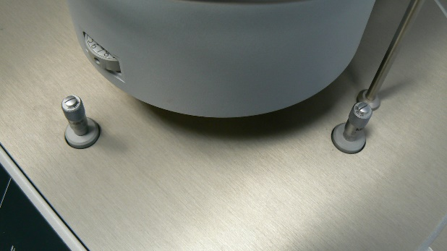
Improved DTA- or high temperature DSC construction
Screws regulating position and inclination
Heat flux base plate from Pt and thermoelements
The pump system, high precision gas flux controllers and platinum made base plates of different construction were added.

Slide 18
Improved DTA- or high temperature DSC -some remarks
Addition of the defined way of the heat flux by the Pt base caused decrease of the thermal gradients in the sample and changed type of the cups.
The main signal changed for the heat flux in J/mg or mW/mg, but all other characteristic features of the classical DTA remained not changed.
The high effective system for evacuation and regulations of the integrated thermal elements position versus massive furnaces does not preserve a linear base line in a full range.
The temperature calibration requires measurements of the 5 different standards with the internally controlled precision.
Awfully expensive spare parts!

Slide 19
Improved DTA- or high temperature DSC -some application areas, only small part!
phase transitions, chemical reaction, decomposition,
melting and freezing temperatures
chemical composition
purity
phase equilibrium diagrams
precipitations and dissolution of phases
In cooperation with TGA much more applications!!
thermal stability
explosive materials
metals and alloys
minerals
oxide glasses SiO₂
chemical compounds
cements, bonding materials (hydratisation and dehydratisation)
soils, clay materials, natural materials
silicates– Si content
oxalates, chlorides, polymorphs organic and not organics

Slide 20
Improved DTA- or high temperature DSC -some remarks
The improved DTA – DSC is hard to be classified as the method. Most of the textbooks discuss its properties and application together with the DSC calorimetry. Most of everything what applies to the method of classical DTA and modern DSC may be applied to the high temperature DSC, so the further discussion concerning the method will be done together with the DSC.
The method of TA technically most similar to the classical DTA is thermogravimetry (TGA –SDT). This method will be discussed next.

Slide 21
TGA and SDT equipment construction
Thermogravimetric measurement shows mass change proceeding under the programmed temperature change, registered like DSC signals in time and temperature. This names TGA;
The signal of the mass change may be differentiated by time or temperature, giving the rate of mass changes or makingg easier characteristic temperatures determination. This names DTGA;
It is advice to use other TA methods in cooperation and use external methods like IR spectroscopy or mass spectroscopy (MS)- very useful in chemical analysis of composition and decomposition;
This needs additional very precise ways for the transport of gaseous or solved in gas products to the spectrometers.
There are many different solutions in the construction of the TGA apparatus.

Slide 22
TGA equipment construction
balance, electronic, compensated
1/ Differential thermogravimetry (DTGA)–noticeable and reliable determination of the size of the effects;
2/ High resolution thermogravimetry (HRTGA) possible with the special furnace construction;
3./ High pressure thermogravimetry (HPTGA) – special construction for pressurisation and pressure control;
Very useful are external analytical methods, relatively easy to apply.
Useful external analytical methods: infrared spectroscopy, mass (quadrupole) spectroscopy
Dm
T₀
The system may be easily rearranged horizontally!

Slide 23
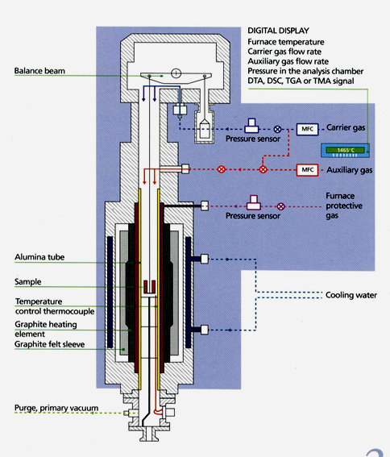
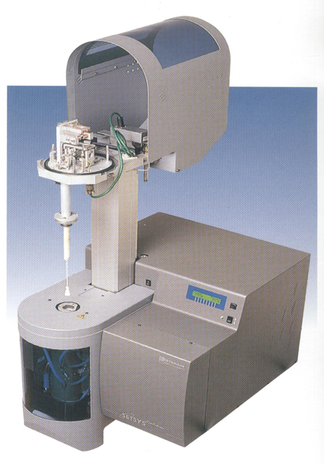
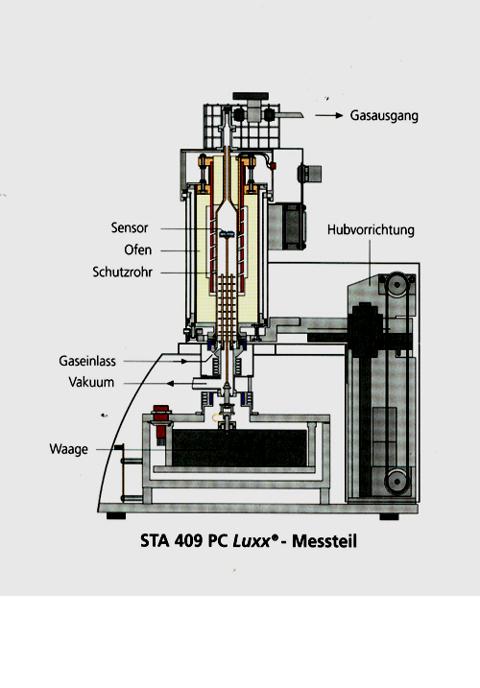
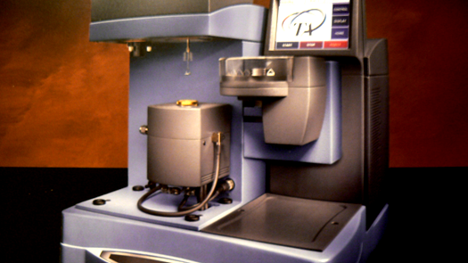
Examples of TGA equipment constructions

Slide 24
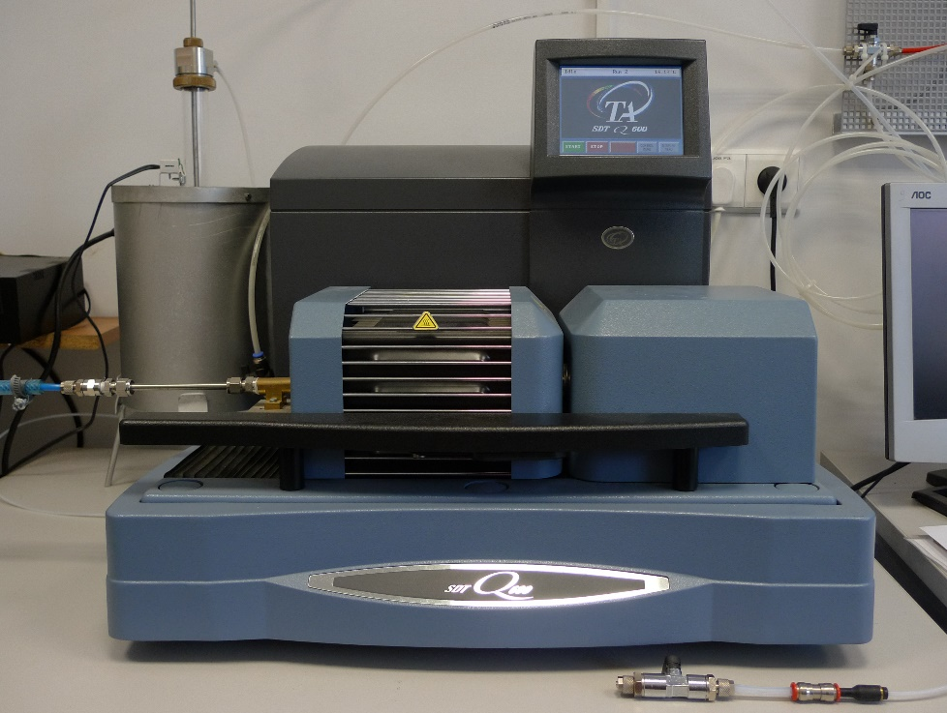
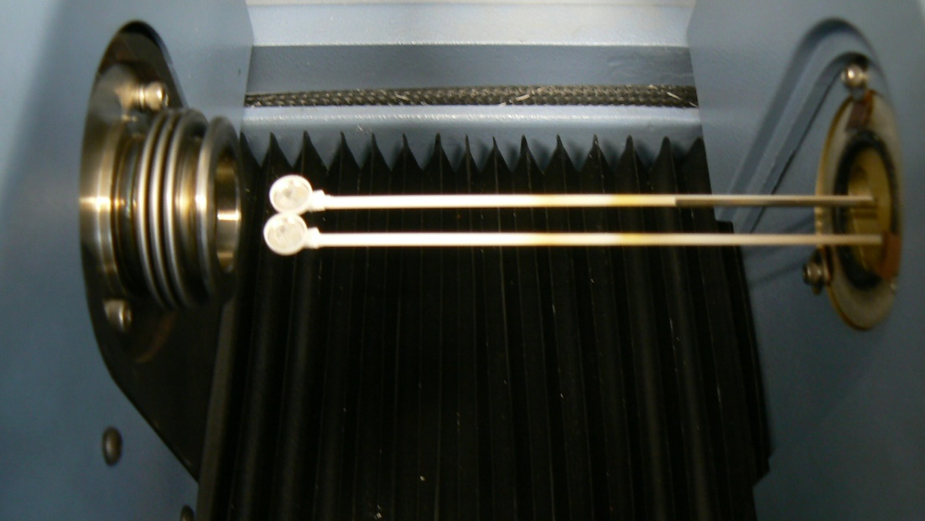
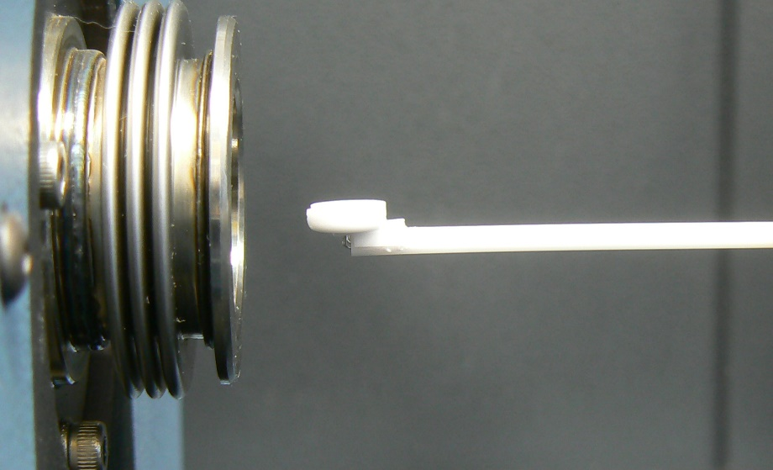
Examples of SDT SDTG (simultaneous differential techniques) equipment construction of Q600 TAI
Spectrometric path- MS, FTIR, Raman spectroscopy
DTA thermoelements
Internal computer
Additional, reactive gas supply
Thermocouples Pt –Rh. Is Pt a good solution?
O-ring seal
Electronic compensated balance unit control and regulation
Pt -Furnace RT-1500 C

Slide 25
TGA – SDT applications
Surface oxidation kinetics e.g.: coatings, natural minerals, metals, diamond CVD coatings, Graphene, graphite oxidation /reduction;
Oxidation of the composite TiC-XB₂ (X=Zr, Hf)
Oxidation of the alloys Mg – Li
Gum pyrolysis etc.
Processes in which gas fraction is evolved or synthetized :
corrosion,
decomposition
Polymers and pharmaceutics decomposition or some phases content
Building materials: content of water in cements and concretes and other bonding materials (hydratization and dehydratization)
Determination of the Ca(OH)₂ content – reaction (C-H-S) –(reakcja puculanowa), properties of the cement composite, concrete etc.
Quality control: e.g.. Mom dolomite lime , mineral wool, composites -polymer/ non-organic filler

Slide 26
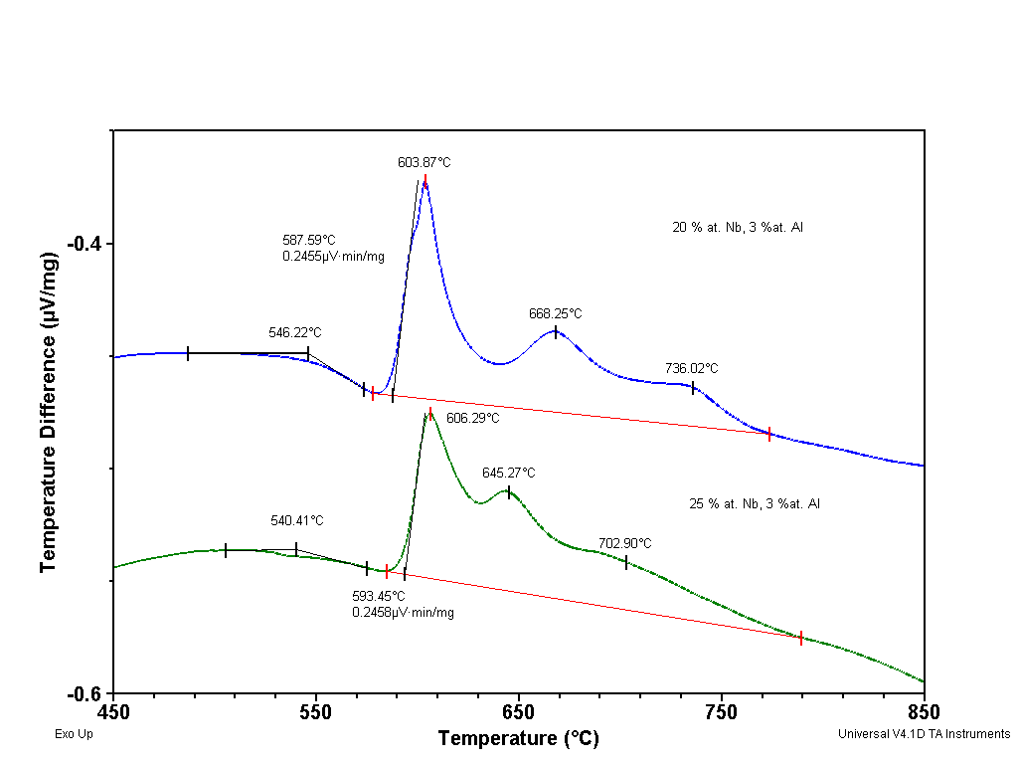
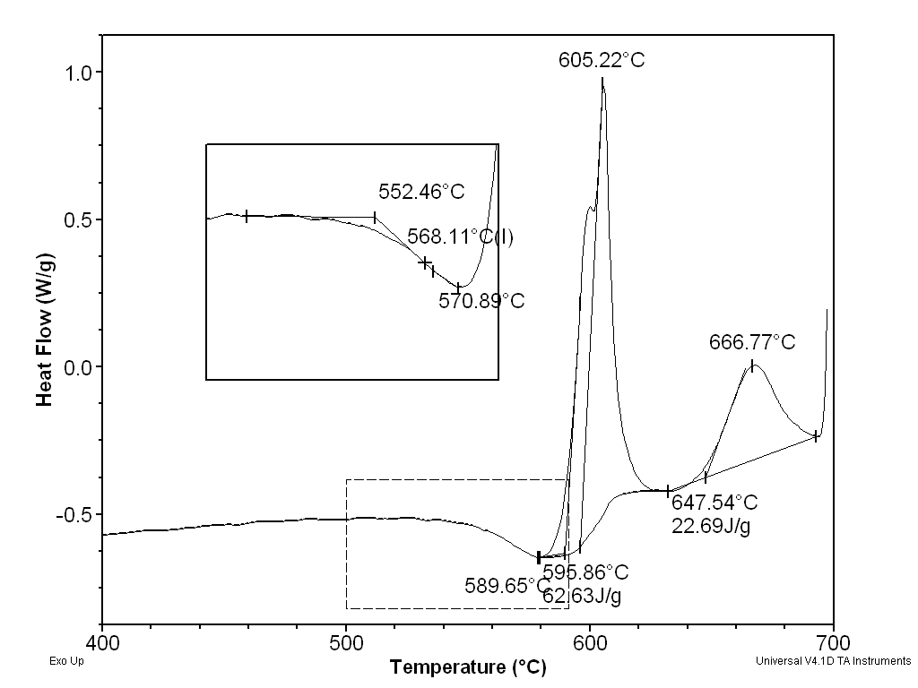
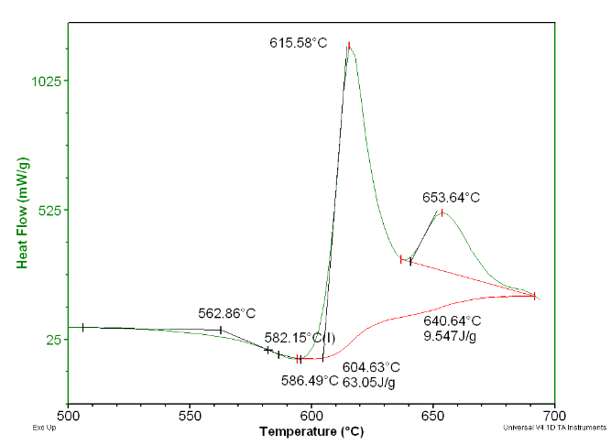
Could SDT be used as a common DTA or DSC?
Yes, a proper calibration has now 4 steps:
Base line calibration empty cell
Temperature scale calibration
Sapphire Cp calibration
Additional calibration of the melting enthalpy for the cell constant: c= ΔHexp/ΔH standard in the required temperature range
Remains the oryginal shape of the base line and larger thermal inertia = thermal lag

Slide 27
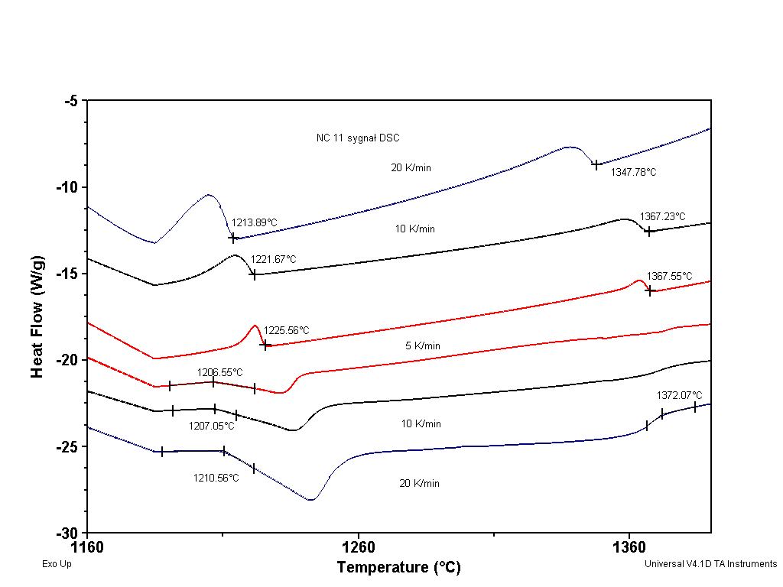
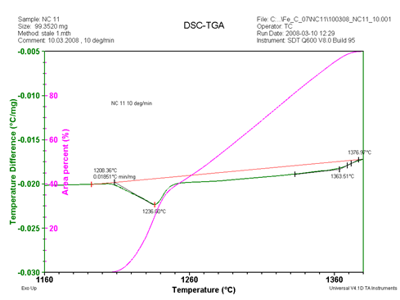
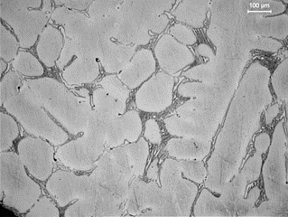
Another use of SDT be used as a DSC – the reason: high temperature and Fe reaction with the gas atmosphere, detection of the unwanted oxidation process
Steel NC 11: Fe₈₃Cr₁₂C_{2,5}(Si, Mn, Mo, Ni) determination of the amount of the liquid phase by the melting and solidification.
% of the liquid phase
DSC
Philosophy: weak effects in heating verified by effects in cooling, but the % of crystallinity determined from the melting effects calibrated in DSC. The oxidation excluded with TGA signal.

Slide 28
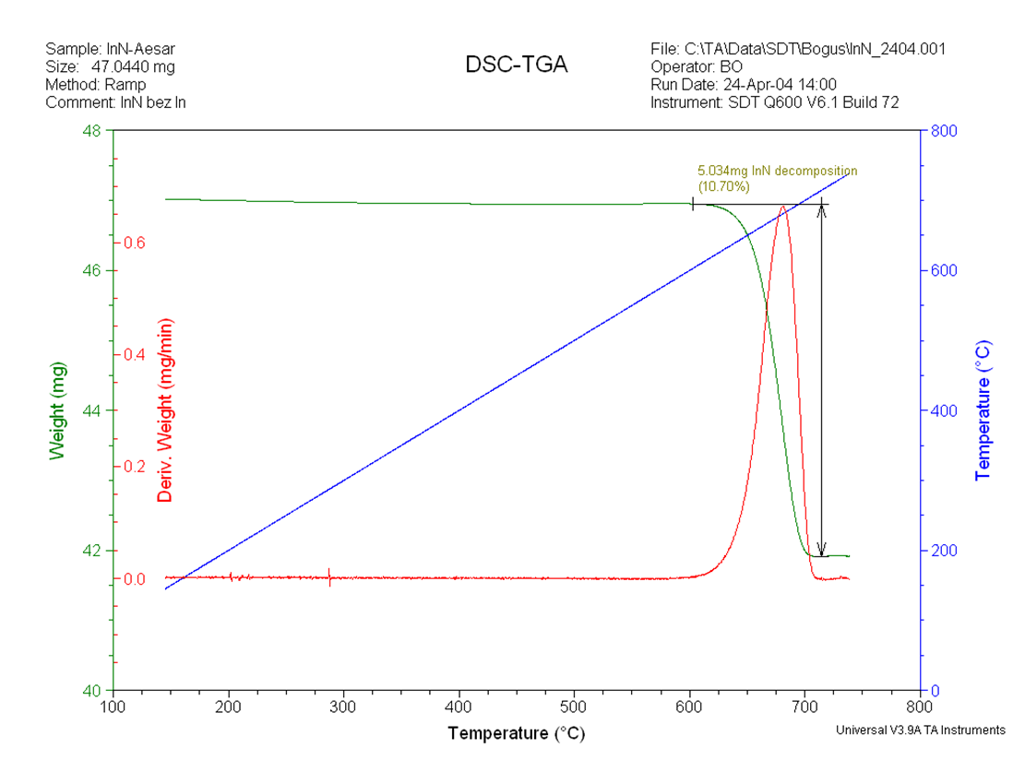
Typical signals of SDT used for a TGA
For TGA next calibration procedure must be performer- the run with the empty crucibles and with the standard weights;
Disadvantage - not every type of crucibles give a proper relations between signals to give coefficient for the scale.
Decomposition of the InN viskers by:
Dr B. Onderka: Właściwości termodynamiczne fotonicznych materiałów Ga-In-N” habilitacja; IMIM PAN 2006

Slide 29
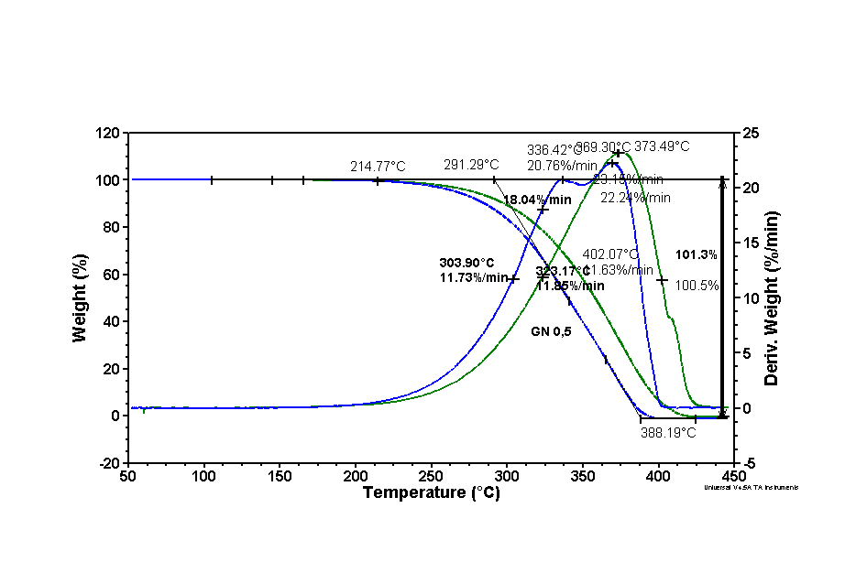
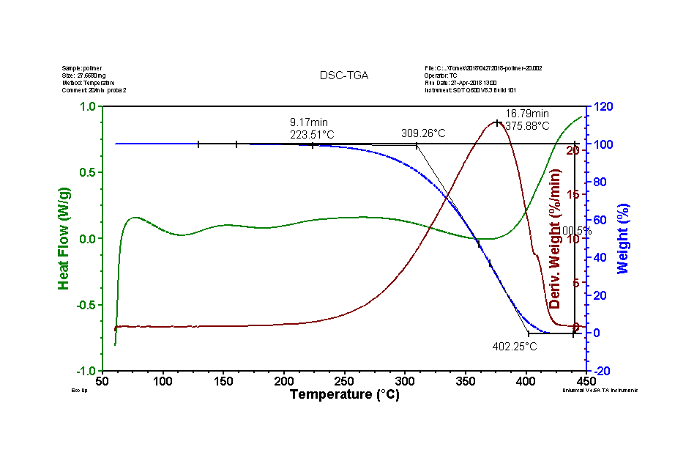
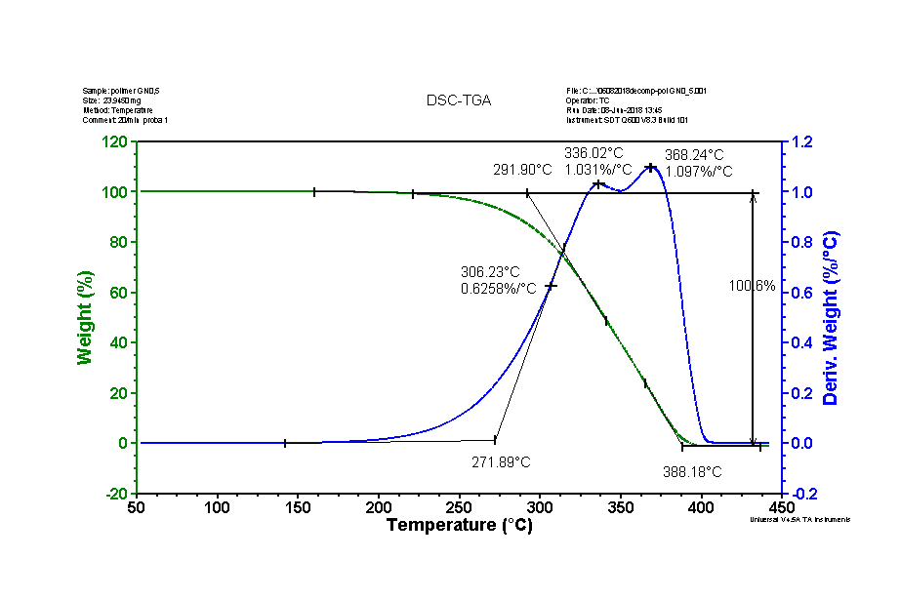
Decomposition of the macromolecule polymers, use of the signals of SDT used for a TGA
Transition rate directly from DTGA
A standard polymer commercial production
GN content 0,5
The problem concerns temperature range in which polymer which contain macromolecules with application for the energy storage remains stable. TGA/ DTGA/ and DSC signals used.

Slide 30
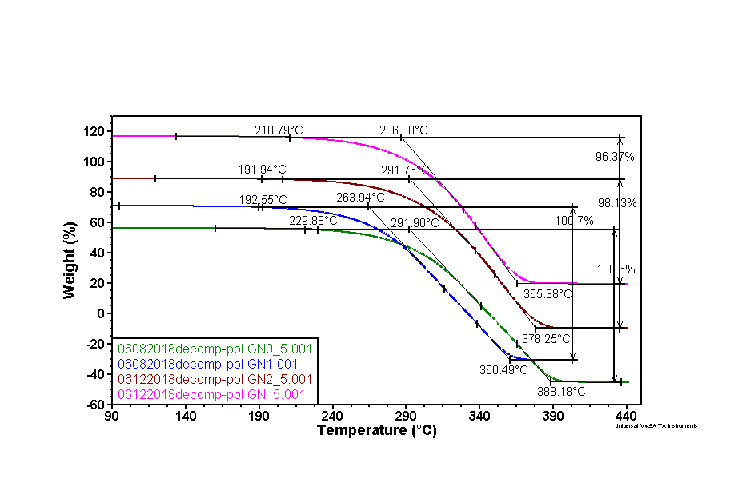
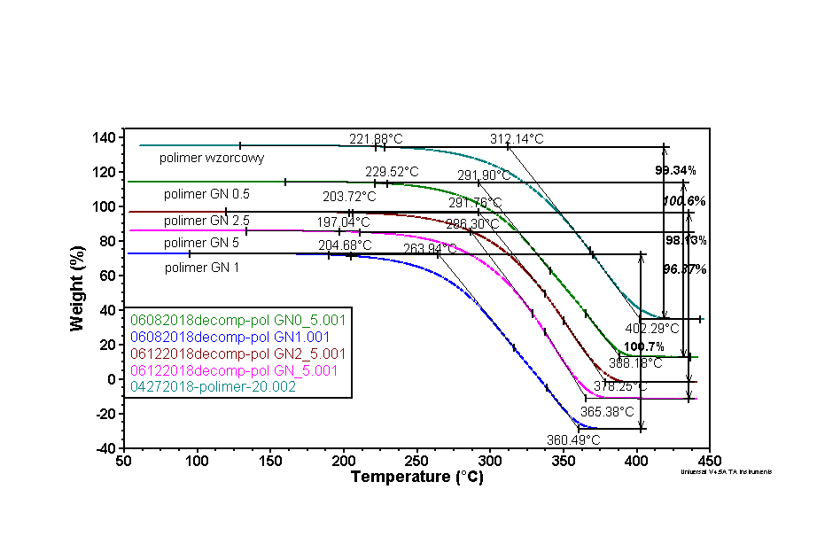
Decomposition of the macromolecule polymers, use of the signals of SDT used for a TGA
Further, the influence of the GN content on the standard polymer thermal stability and decomposition was investigated.

Slide 31
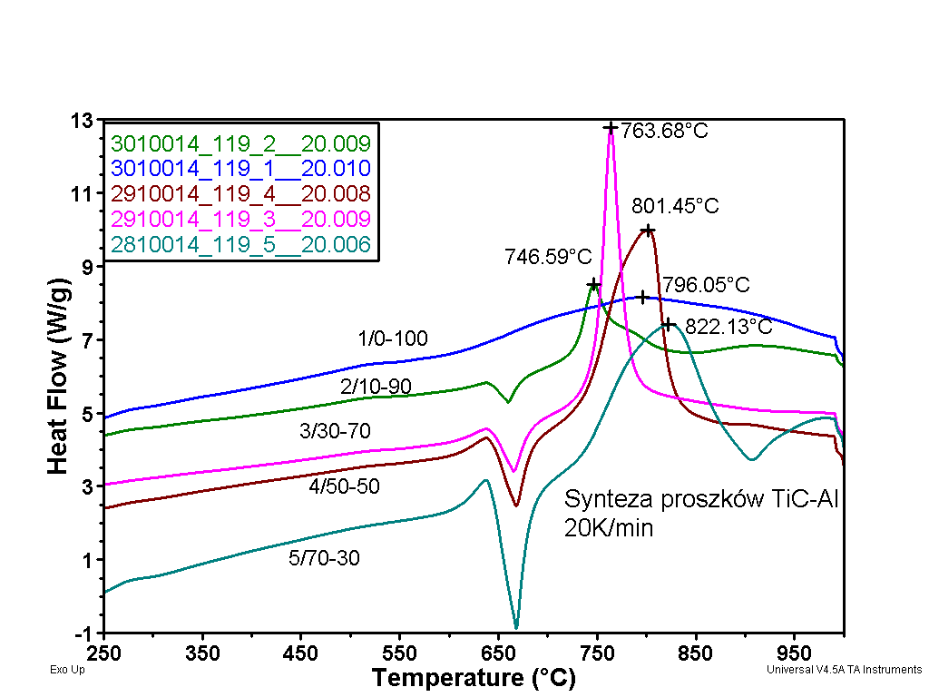
Example of the synthesis of components
The problem concerns self propagating synthesis of the TiC- Al powders mixed in different proportions
and compressed. What is optimal proportion of powders, what are optimal conditions of reaction?

Slide 32
Oxidation processes
The oxidation process of metals proceeds by nucleation and growth. The kinetics depends on the possibility of oxygen ions to bond metallic ions. This is related to the ability of oxygen to contact the free surface and later to diffuse into oxide layer. This determines the kinetic, different for a thin and thick layers.
The oxygen diffusion is influenced by the matrix structure. There is possible diffusion:
Along grain boundaries
Through crystalline network
Through grain boundaries
All type of defects and particles included may influence the diffusion
A common kinetic equation is $y^{n}=Ct+D$
$y \left[s/t\right]=K\sqrt[n]{t }$+ G
n= 1 ÷3 but most often 2. However, logarithmic growth rate, „broken” or composed of linear and parabolic parts are also possible.

Slide 33
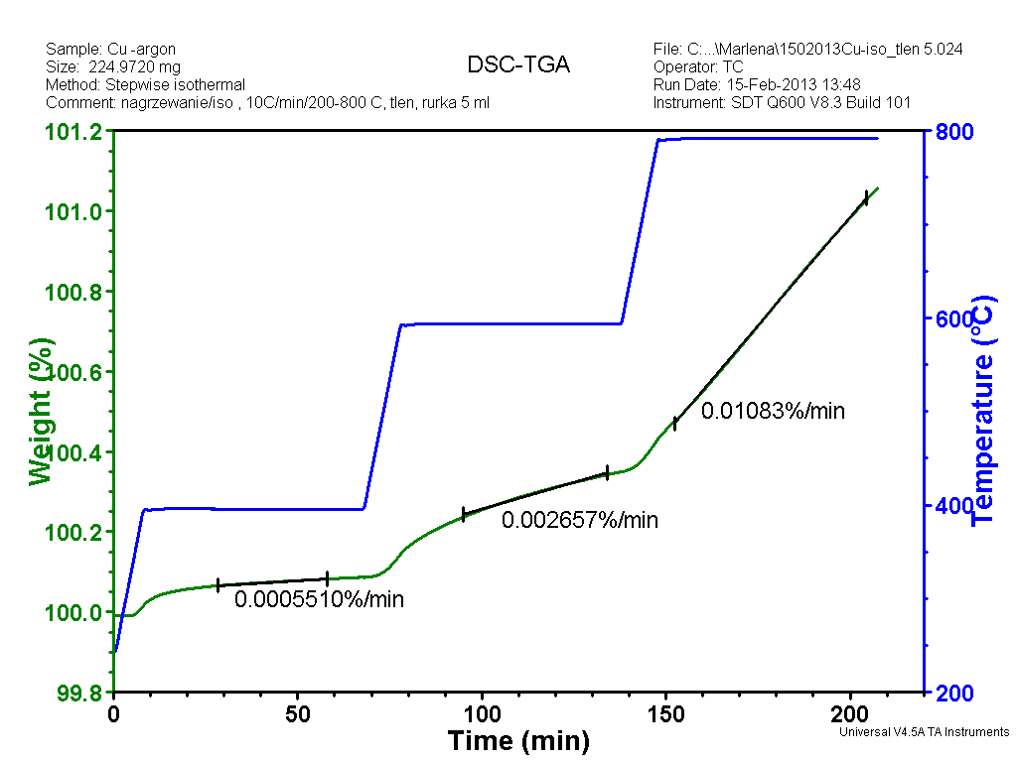
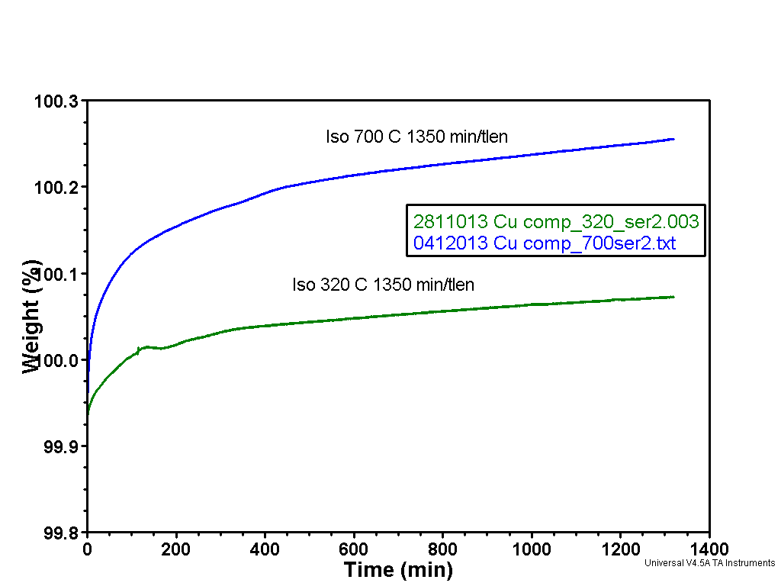
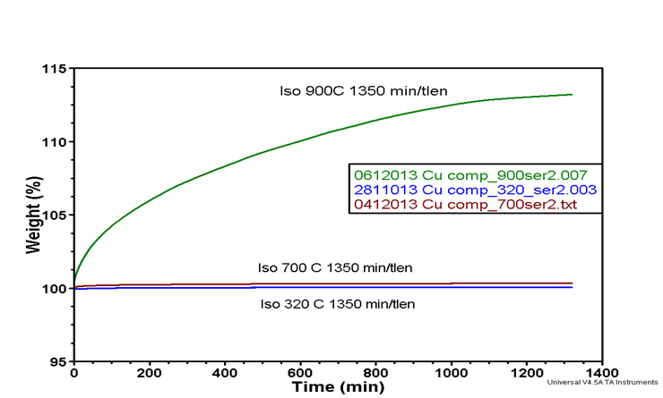
Oxidation processes in case of Cu-Al2O3 composite
„wise steps” methods for isothermal process
Isothermal oxidation at 320 and 700ºC in oxygen

Slide 34
Oxidation processes in case of Cu-Al2O3 composite microstructure
320ºC 700ºC 900ºC

Slide 35
The end!

